Slide 1
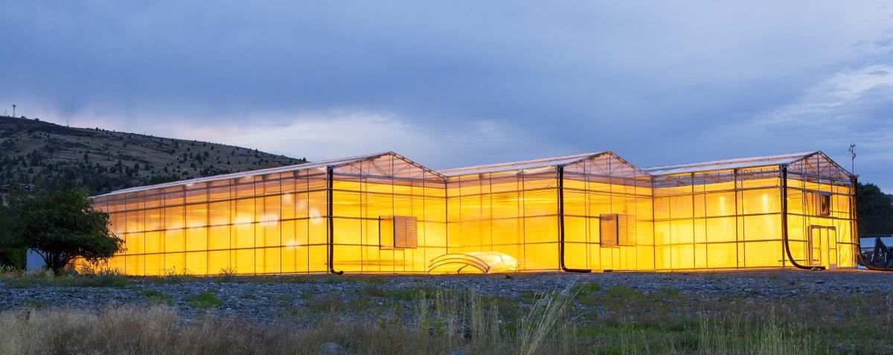

Strategic Approaches for Rural Communities

Slide 2
Definition
Economic Development
… is the process of improving a community’s well-being through job creation, business growth, and income growth (factors that are the typical and reasonable focus of economic development policy), as well as through improvements to the wider social and natural environment that strengthen the economy.
(Moore et al., 2006)

Slide 3
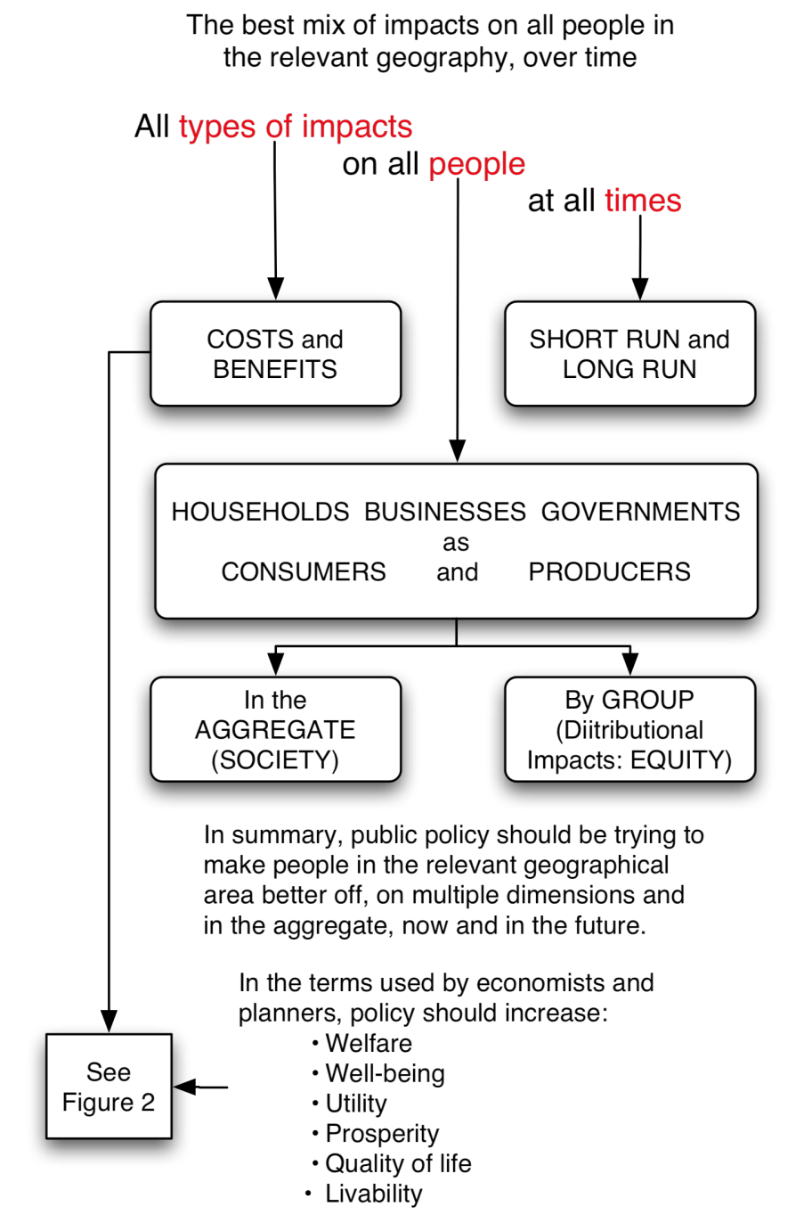
Why do Economic Development?
Economic development intends to make people better off
  In multiple dimensions
  Now, and in the future

Slide 4
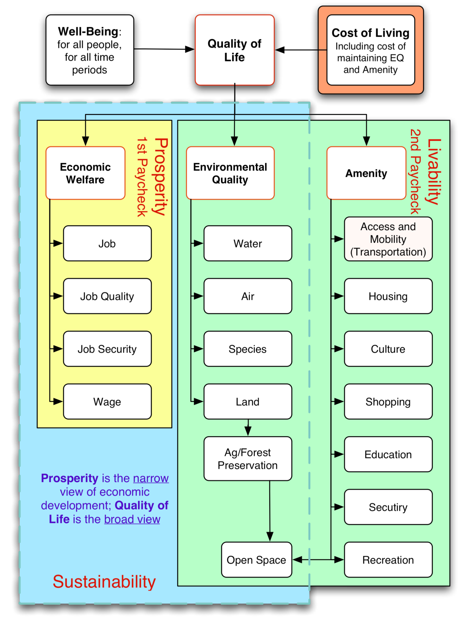
The Broad View
It is about prosperity (the first paycheck), and
Livability (the second paycheck)

Slide 5
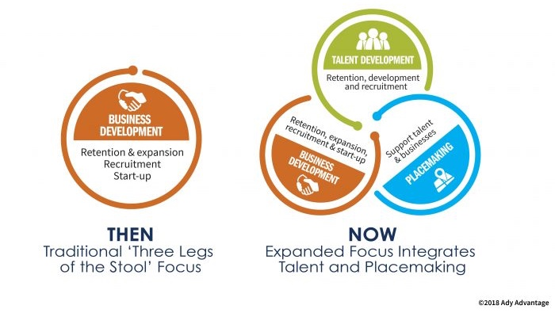
The “Three Legs of the Stool” of Economic Development

Slide 6
Five Levels of Development
Level | Description
Organizational Development | Creating and maintaining a recognized and legitimate forum for exchanging ideas and address the needs of the community. This allows you to set a strategy, fundraise, and work with partners in an efficient manner.
Product Development | Investments that are maintained, upgraded, or developed by labor and capital to improve the community. This may include infrastructure, downtown areas, gateways, business parks or speculative buildings
Market Development | Activities that focus on recruiting individuals who would enhance the economy, such as retired citizens or lone eagles, and enlarging the market area in which they could receive products and services.
Business Development | Programs that nurture business growth and investment. These are often the core of most economic development activities and include business attraction, retention and expansion, tourism, and start-up and emerging businesses.
Workforce Development | Policies that build the skills of the local workforce. This includes partnerships between business, education, and government so that all residents can be contributing members of the local economy.

Slide 7
The Role of Public Policy
Source: Moore, et al, 2007

Slide 8
Objectives of Economic Development

Slide 9
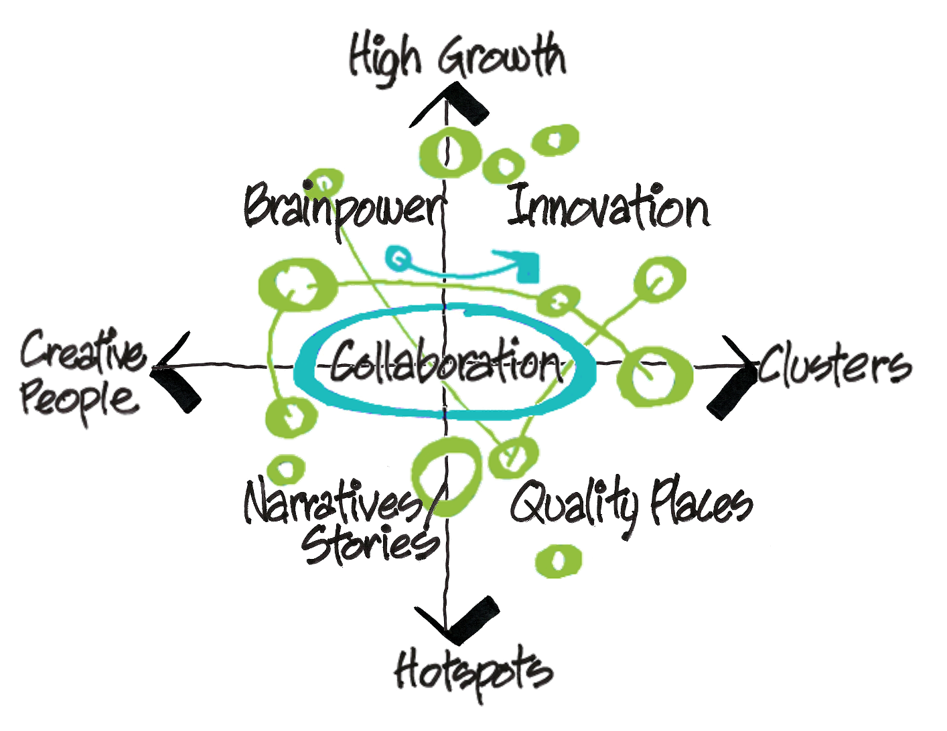
Understand Your Community’s Competitive Advantages

Slide 10
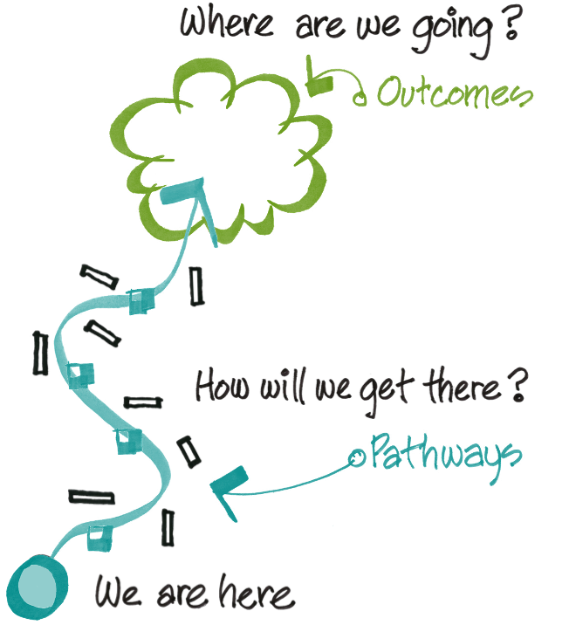
The Winding Path of Economic Development
How can we get there if we don’t know where we’re going?
All strategy uses outcomes to define pathways to achieving those outcomes

Slide 11
Strategic Planning or Strategic Investment?
Strategic Planning
Establish a committee
Conduct environmental scan (SWOT)
Develop vision, goals and strategies
Implement
Strategic Investment
Define desired outcomes
Develop pathways to move towards outcomes
Identify strategic public investments

Slide 12
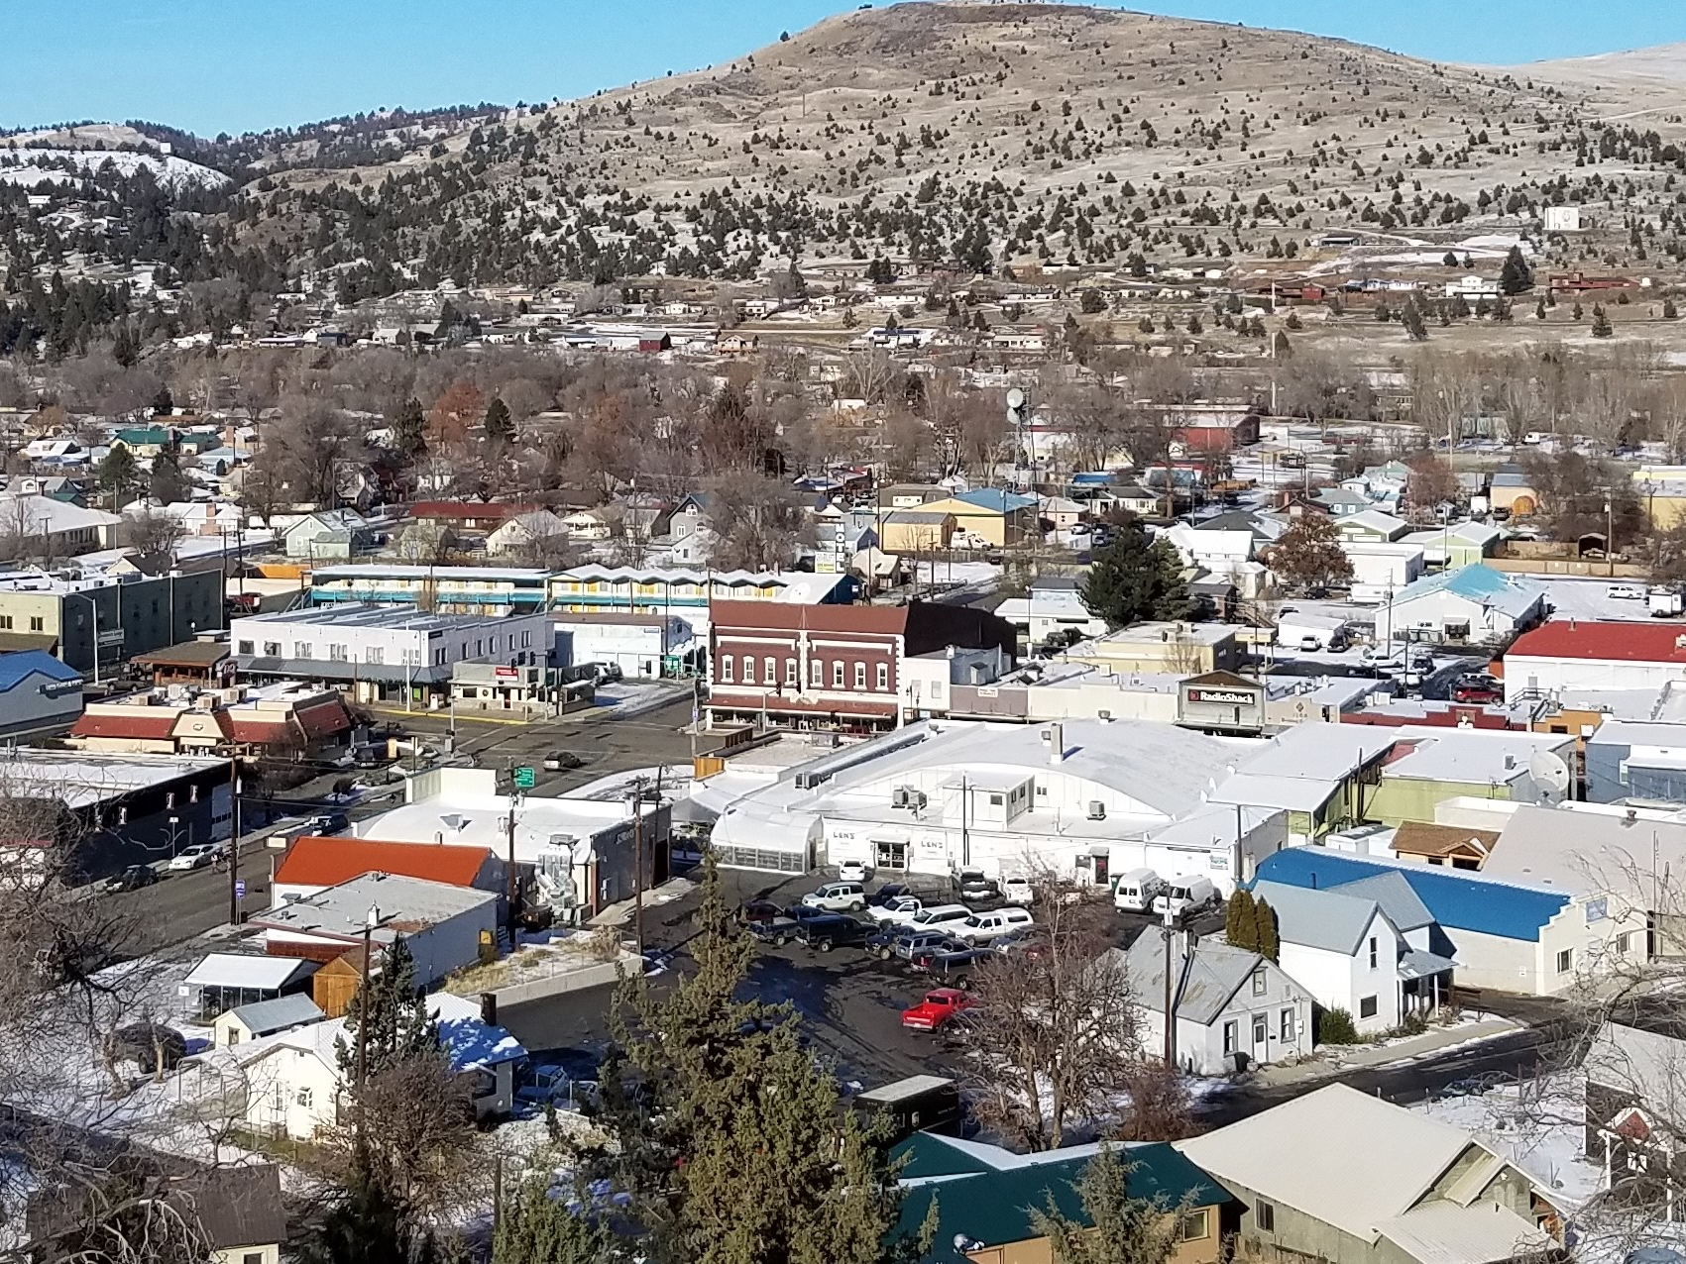
City of John Day Overview

Slide 13
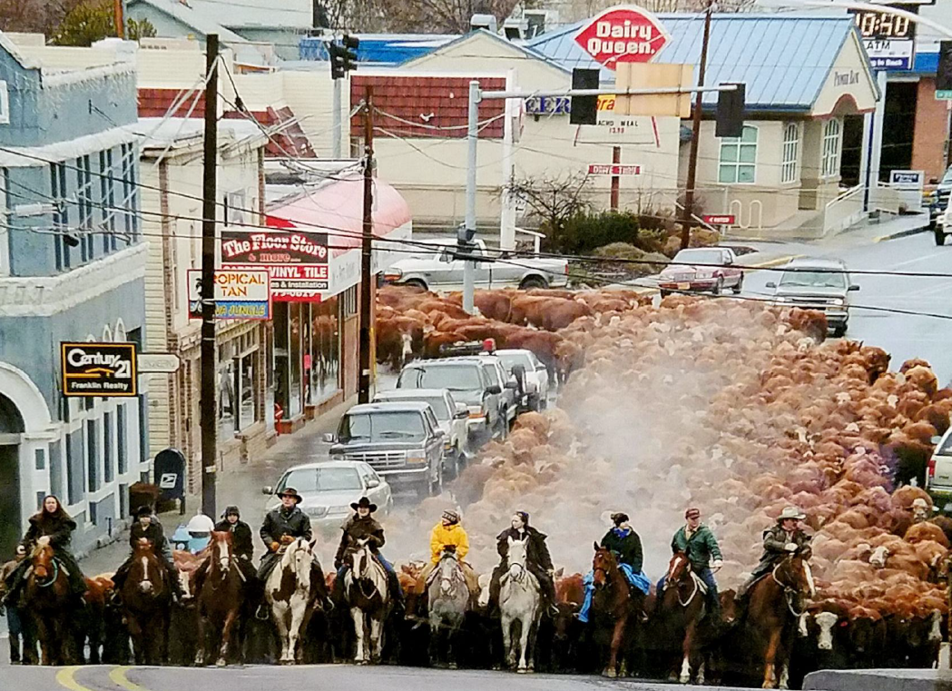
Where the Old West Meets the New West

Slide 14
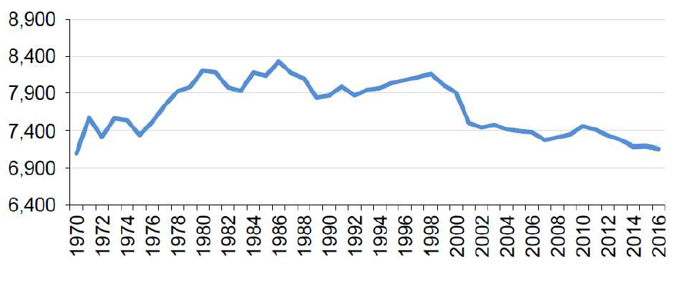
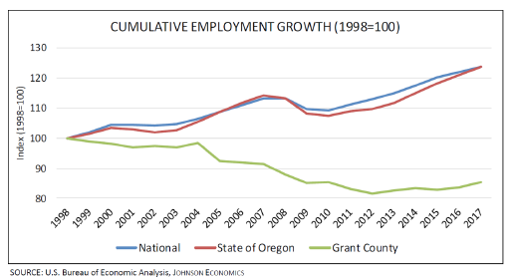
John Day’s Socioeconomic Challenges
Recover the population we’ve lost, then maintain the gains
Lost over 1,000 residents countywide (15%); more than 300 in John Day
Lost half our student enrollment
Grew for the first time in 2020!

Slide 15
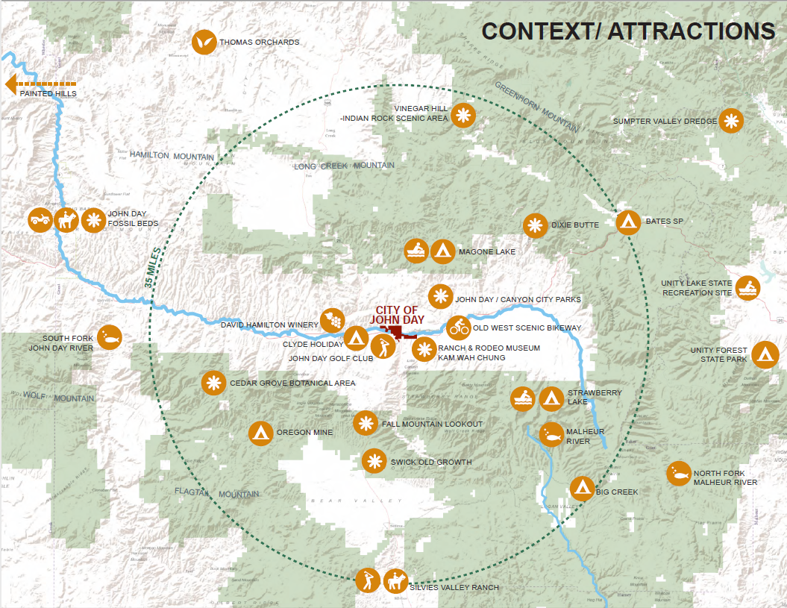
John Day Regional Context

Slide 16
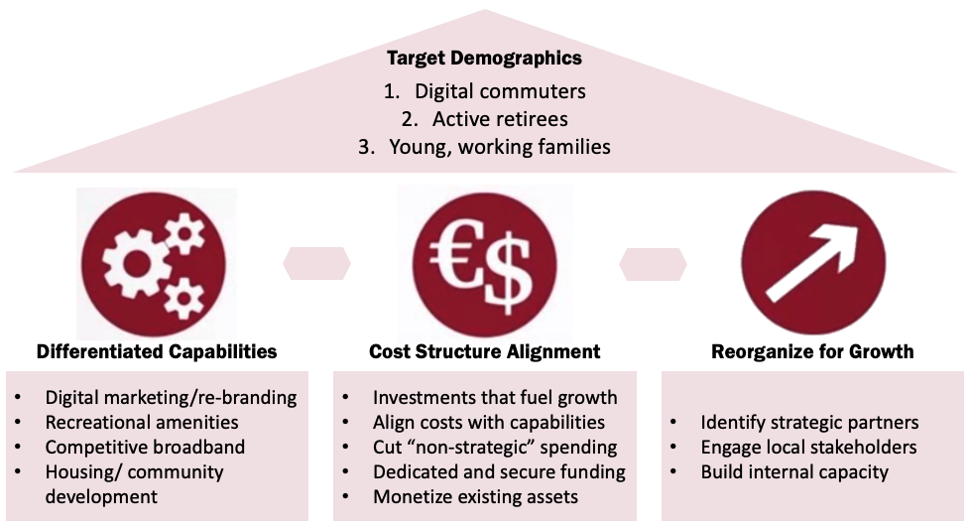
John Day’s Strategy for Growth

Slide 17
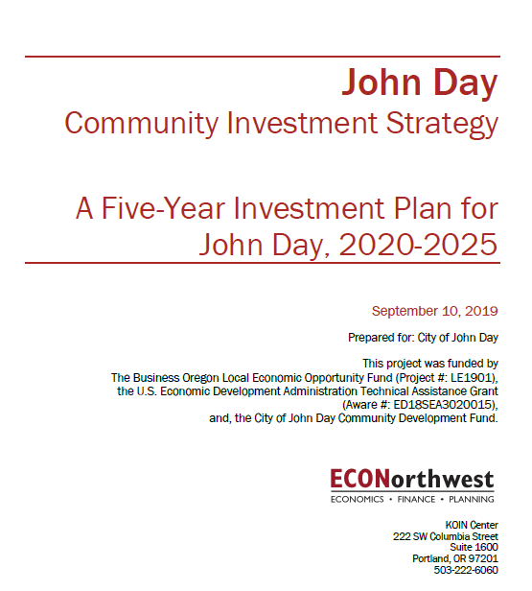
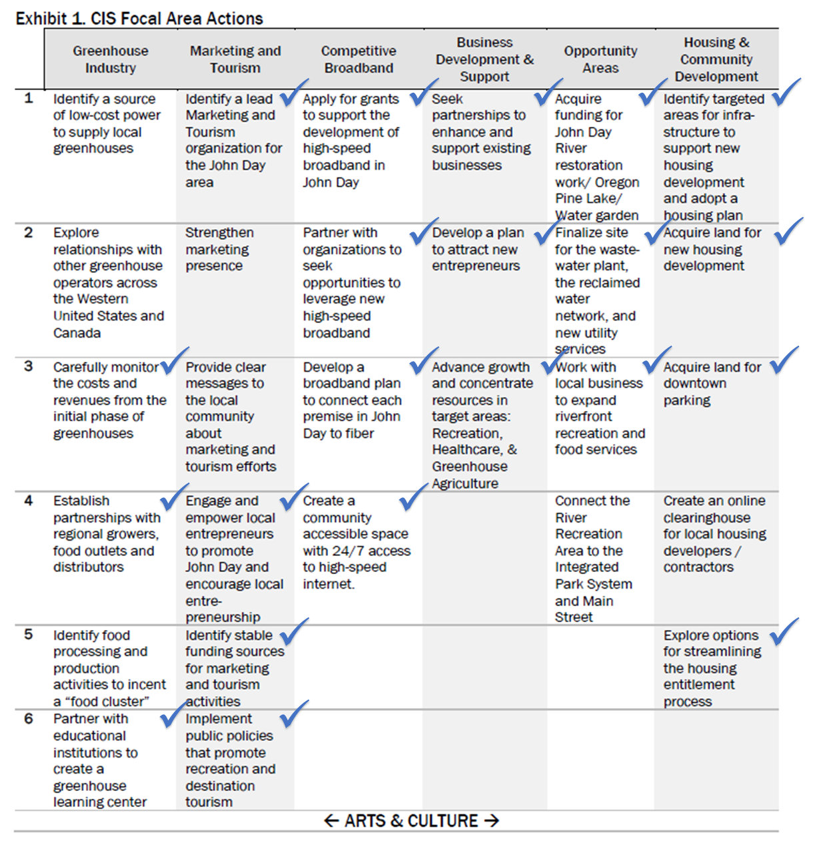
Community Investment Strategy
Adopted in our Comprehensive Economic Development Strategy
Greenhouse Industry
Marketing & Tourism
Competitive Broadband
Business Development
Opportunity Areas
Housing & Community Development
Arts & Culture

Slide 18
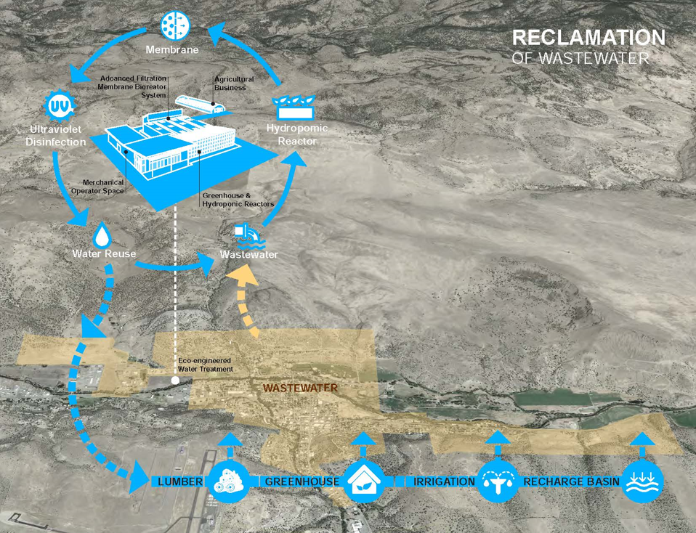
Wastewater → Reclaimed Water (Engine)

Slide 19
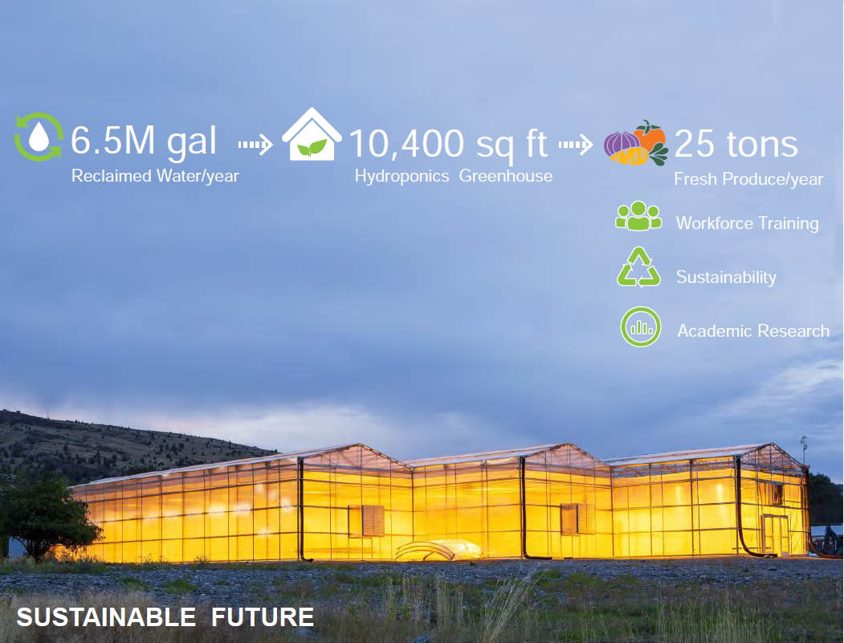
Water Sustainability → Food Sustainability

Slide 20
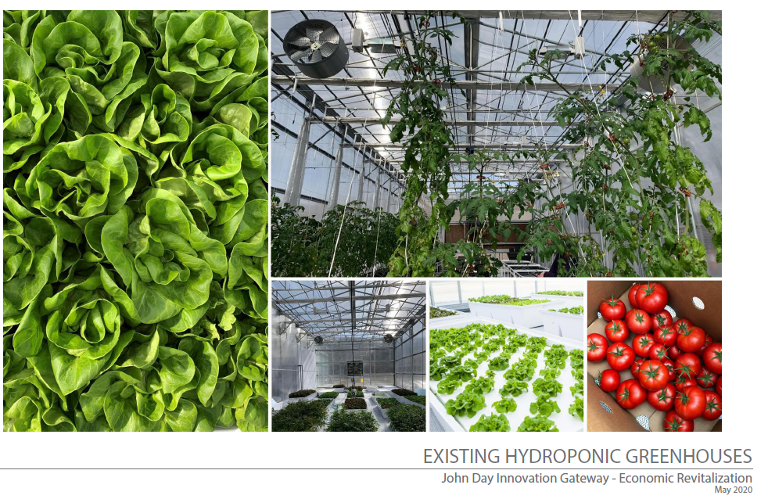
Community Supported Agriculture

Slide 21
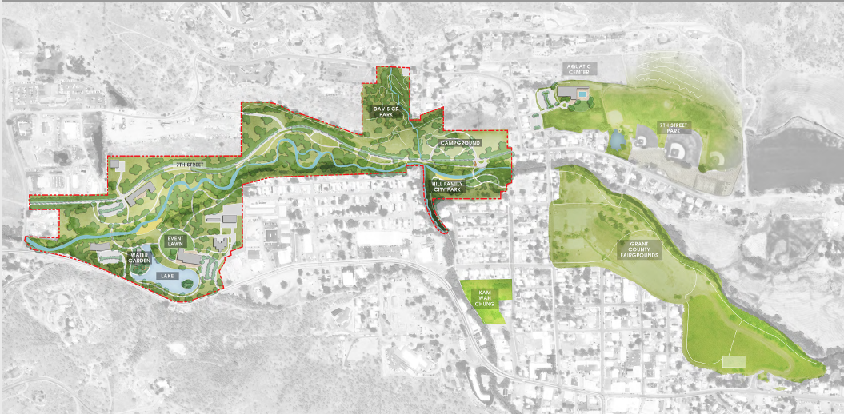
Innovation Gateway & Integrated Park System
TGM-funded Area Plan for Brownfield Reclamation & Riverfront Restoration

Slide 22
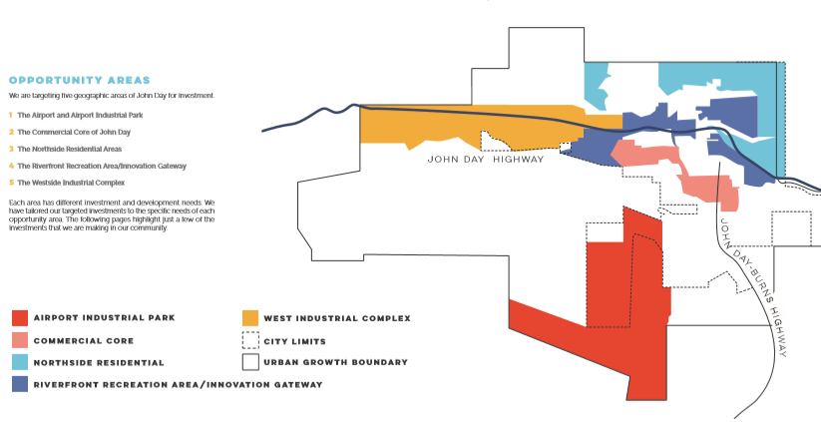
Opportunity Areas identified in CEDS

Slide 23
Housing & Community Development Incentives
The New Home Incentive Program
  7% cash rebate on new home construction (based on the increase in the property’s assessed value)
  Payment of system development charges on behalf of the property owner (currently $7,354)
Existing Home Remodel Incentive Program
  15% cash rebate (based on the increase in the property's assessed value) on substantial improvements to home facades, structural repairs, major remodels and new additions that add additional rooms and living space.
  The minimum AV increase to qualify for this incentive is $10,000.
Land Development Incentive Program
  Developer/Builder/Property Owner Incentives for horizontal improvements to develop new housing within the Plan Area (private)
  Infrastructure Investment Program where the URA completes improvements specified in a development agreement (public)

Slide 24
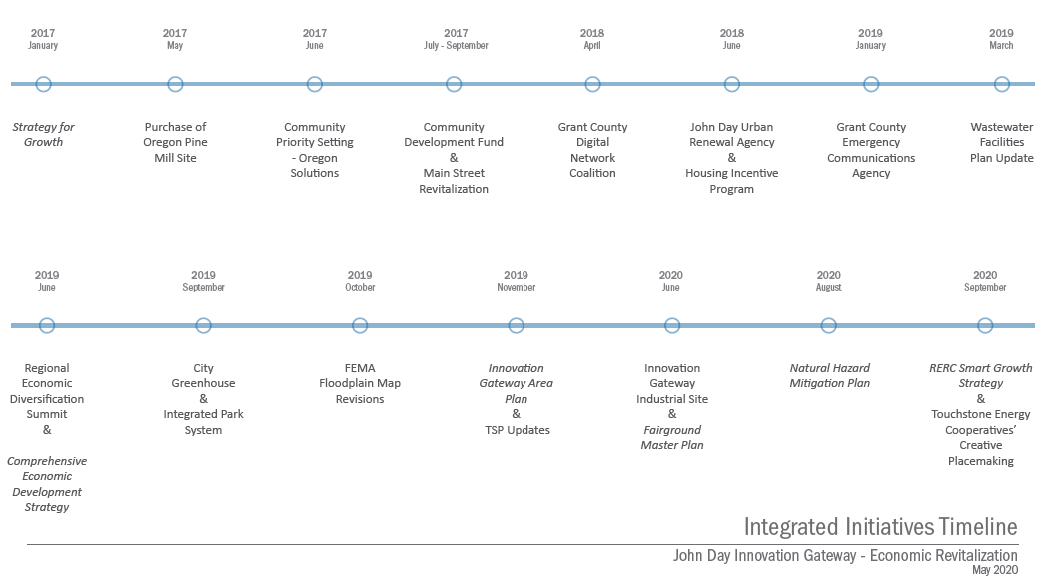
Integrated Initiatives

Slide 25
Earned Media
Other Side of the Hill video: https://vimeo.com/450634863
“What’s Growing in John Day” Oregon Humanities article: https://www.oregonhumanities.org/rll/magazine/feed-fallwinter-2020/whats-growing-in-john-day/
“Recreation and Revitalization in John Day” Western Planner article: https://www.westernplanner.org/2020articles/2020/7/15/recreation-and-revitalization-in-john-day
“Fertile Future” Oregon Business article: https://www.oregonbusiness.com/article/tech/item/18734-fertile-future
2019 LOC Award Press Release: https://www.orcities.org/application/files/4315/7005/1284/2019_Excellence_Award_News_Release-FINAL-2.pdf
“Rethinking the River” Oregon Business article: https://www.oregonbusiness.com/article/real-estate/item/18542-rethinking-the-river
“Desert Prospector” Oregon Business article: https://www.oregonbusiness.com/article/economy/item/18385-this-is-not-your-grandaddy-s-government

