Slide 1

Rowan Percheron Data Center
Morrow County Planning Commission
Zone Change and Goal Exceptions Request
June 27, 2023
(Docket No. AC-145-23, AC(Z)-146-22, AZM-147-23)

Slide 2



Today’s Presentation
Introduction of the Team
Applicant’s Request
Overview of the Project Location
Consultation and Studies
Staff Report and Public Comments
  Water Supply
  Alternatives Analysis
  Economic Impact Benefits
  Construction Traffic and Road use
  Proposed Conditions
Questions
Rowan: Bobby Hollis, COO; Kirstin Gunderson, VP of Site Strategy; David Schiflet, Director of Development; and Martin Romo, Sr. Director of Economic Development & Policy
Hubbell: Nathaniel Brown, Manager, Public Affairs
ERM: Nikki Payne, Project PM
DWT: Elaine Albrich, Partner; Olivier Jamin, Associate

Slide 3
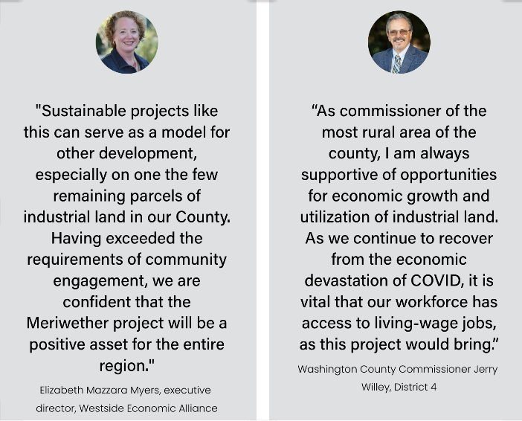
Applicant
What leaders have to say about Rowan’s projects:
Rowan was founded in 2020 with a mission to deliver high-quality digital infrastructure solutions to hyperscale customers. Rowan partners with customers who share our values and our deep commitment to sustainability and responsible resource use.
The Rowan team brings decades of experience in data center development and energy to our portfolio of active projects located throughout the US.

Slide 4
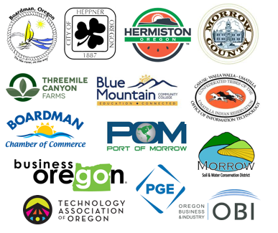

Stakeholder and Community Engagement
Building meaningful relationships in the community with early and upfront information sharing and engagement.
Understand big issues facing community
Address initial questions about project
Explore opportunities to collaborate long-term
Keep community up to date

Slide 5
Applicant’s Request
Zone Change and Comprehensive Plan Amendment for 274 acres
    Exclusive Farm Use → Industrial (MG) + Limited Use Overlay to limit to data center only
    Goal 3 exception to allow MG zoning and data center use
    Goal 11 exception to extend Port of Morrow water service
    Goal 14 exception to allow scale of data center development
Request requires Planning Commission review and make recommendation to Board of County Commissioners. Board makes the final decision on the request.
Staff recommended 2 hearings before Planning Commission. First evidentiary hearing tonight then continued hearing for additional Q/A and deliberations on July 25. Applicant to provide written response to Planning Commission questions before 2nd hearing (if needed).

Slide 6
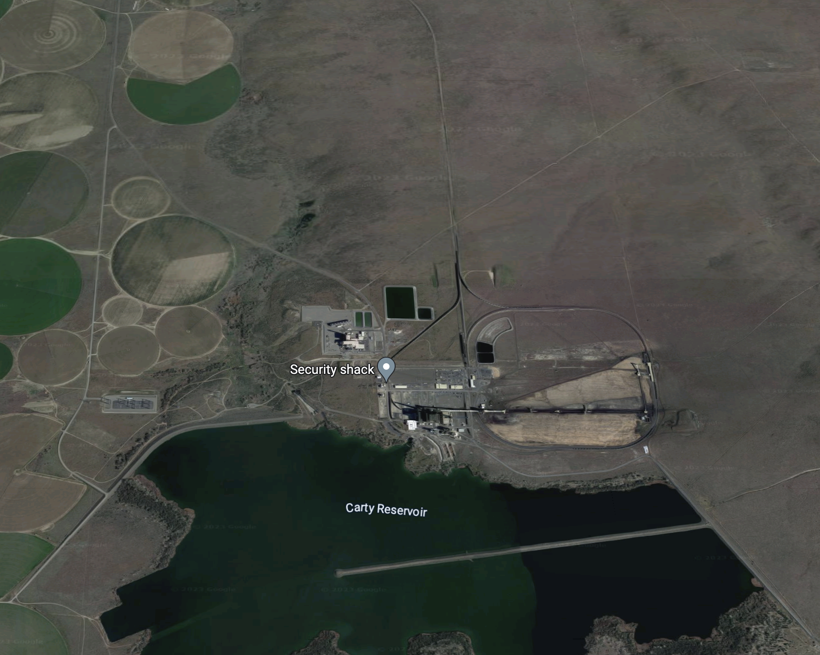
Project Parcel
274-acre parcel off Tower Road, ½ mile from Carty reservoir and power generation site
Owned by Threemile Canyon Farm, no history of agricultural cultivation or no irrigation; poor soil quality
Adjacent to existing transmission ROW, existing (Grassland Switch Station) and planned transmission infrastructure (Grassland Annex Substation) for power supply
Project Parcel

Slide 7
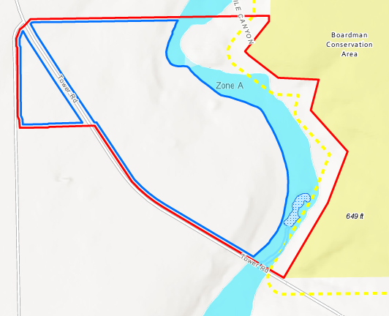
Project Footprint
Project Footprint microsited within Project Parcel to avoid environmental impacts
  190-acre footprint in Project Parcel
  Avoids wetlands and drainages
  Avoids floodplain
  250-foot buffer from conservation area
  Predominately nonarable soils
  Not irrigated

Slide 8
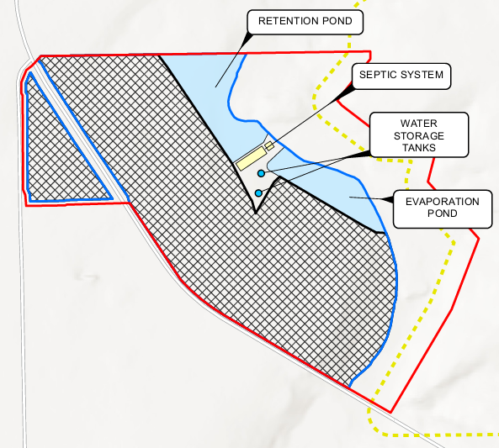
Project Components
Data center campus with multiple data system warehouse buildings
Parking for employees and internal access roads
Onsite septic, stormwater, and wastewater (cooling water) management systems
Fire protection system, including water storage tanks
Back-up power supply
Onsite substation and electrical interconnection equipment

Slide 9
Consultations and Studies
Consultations
Oregon Department of Fish and Wildlife
Oregon Department of State Lands
Morrow County Planning Department
Morrow County Public Works
US Navy, Northwest Region
Confederated Tribes of Umatilla Indian Reservation
Port of Morrow
Boardman Rural Fire District (outreach)
Studies
Soils Analysis Memorandum, ERM (January 2023)
Alternatives Analysis, ERM (April 2023)
Historic Aerial Imagery
Economic Analysis Memorandum, Johnson Economics (February 2023)
Washington Ground Squirrel Protocols Survey Results (May 2023)
Traffic Impact Analysis, Kittelson & Associates (February 2023)
Threatened and Endangered Species Habitat Assessment, AKS (November 2021)
Wetlands Delineation Report and DSL Concurrence, AKS (April 2023)
Cultural Resources Desktop Report, Terracon (October 2021)
Geotechnical Investigation, Terracon (May 2023)

Slide 10
Framework of Application and Proposed Findings:
Applicant provided reasons to justify the goal exception requests
  Reason 1 Rural Industrial Development (Goals 3, 11, 14)
  Reason 2 Minimal Impact to Productive Agriculture (Goals 3, 11, 14)
  Reason 3 Comparative Economic Benefit (Goals 3, 11, 14)
  Reason 4 Air and Water Suitability and Availability (Goal 14)
Applicant analyzed alternative sites before selecting Project Parcel to show no other reasonable sites are available.
Applicant evaluated the Environmental, Economic, Social and Energy consequences of the project on the Project Parcel to find no significant adverse EESE impacts.
Applicant analyzed the potential impacts on surrounding lands to find the project compatible with surrounding land uses.

Slide 11
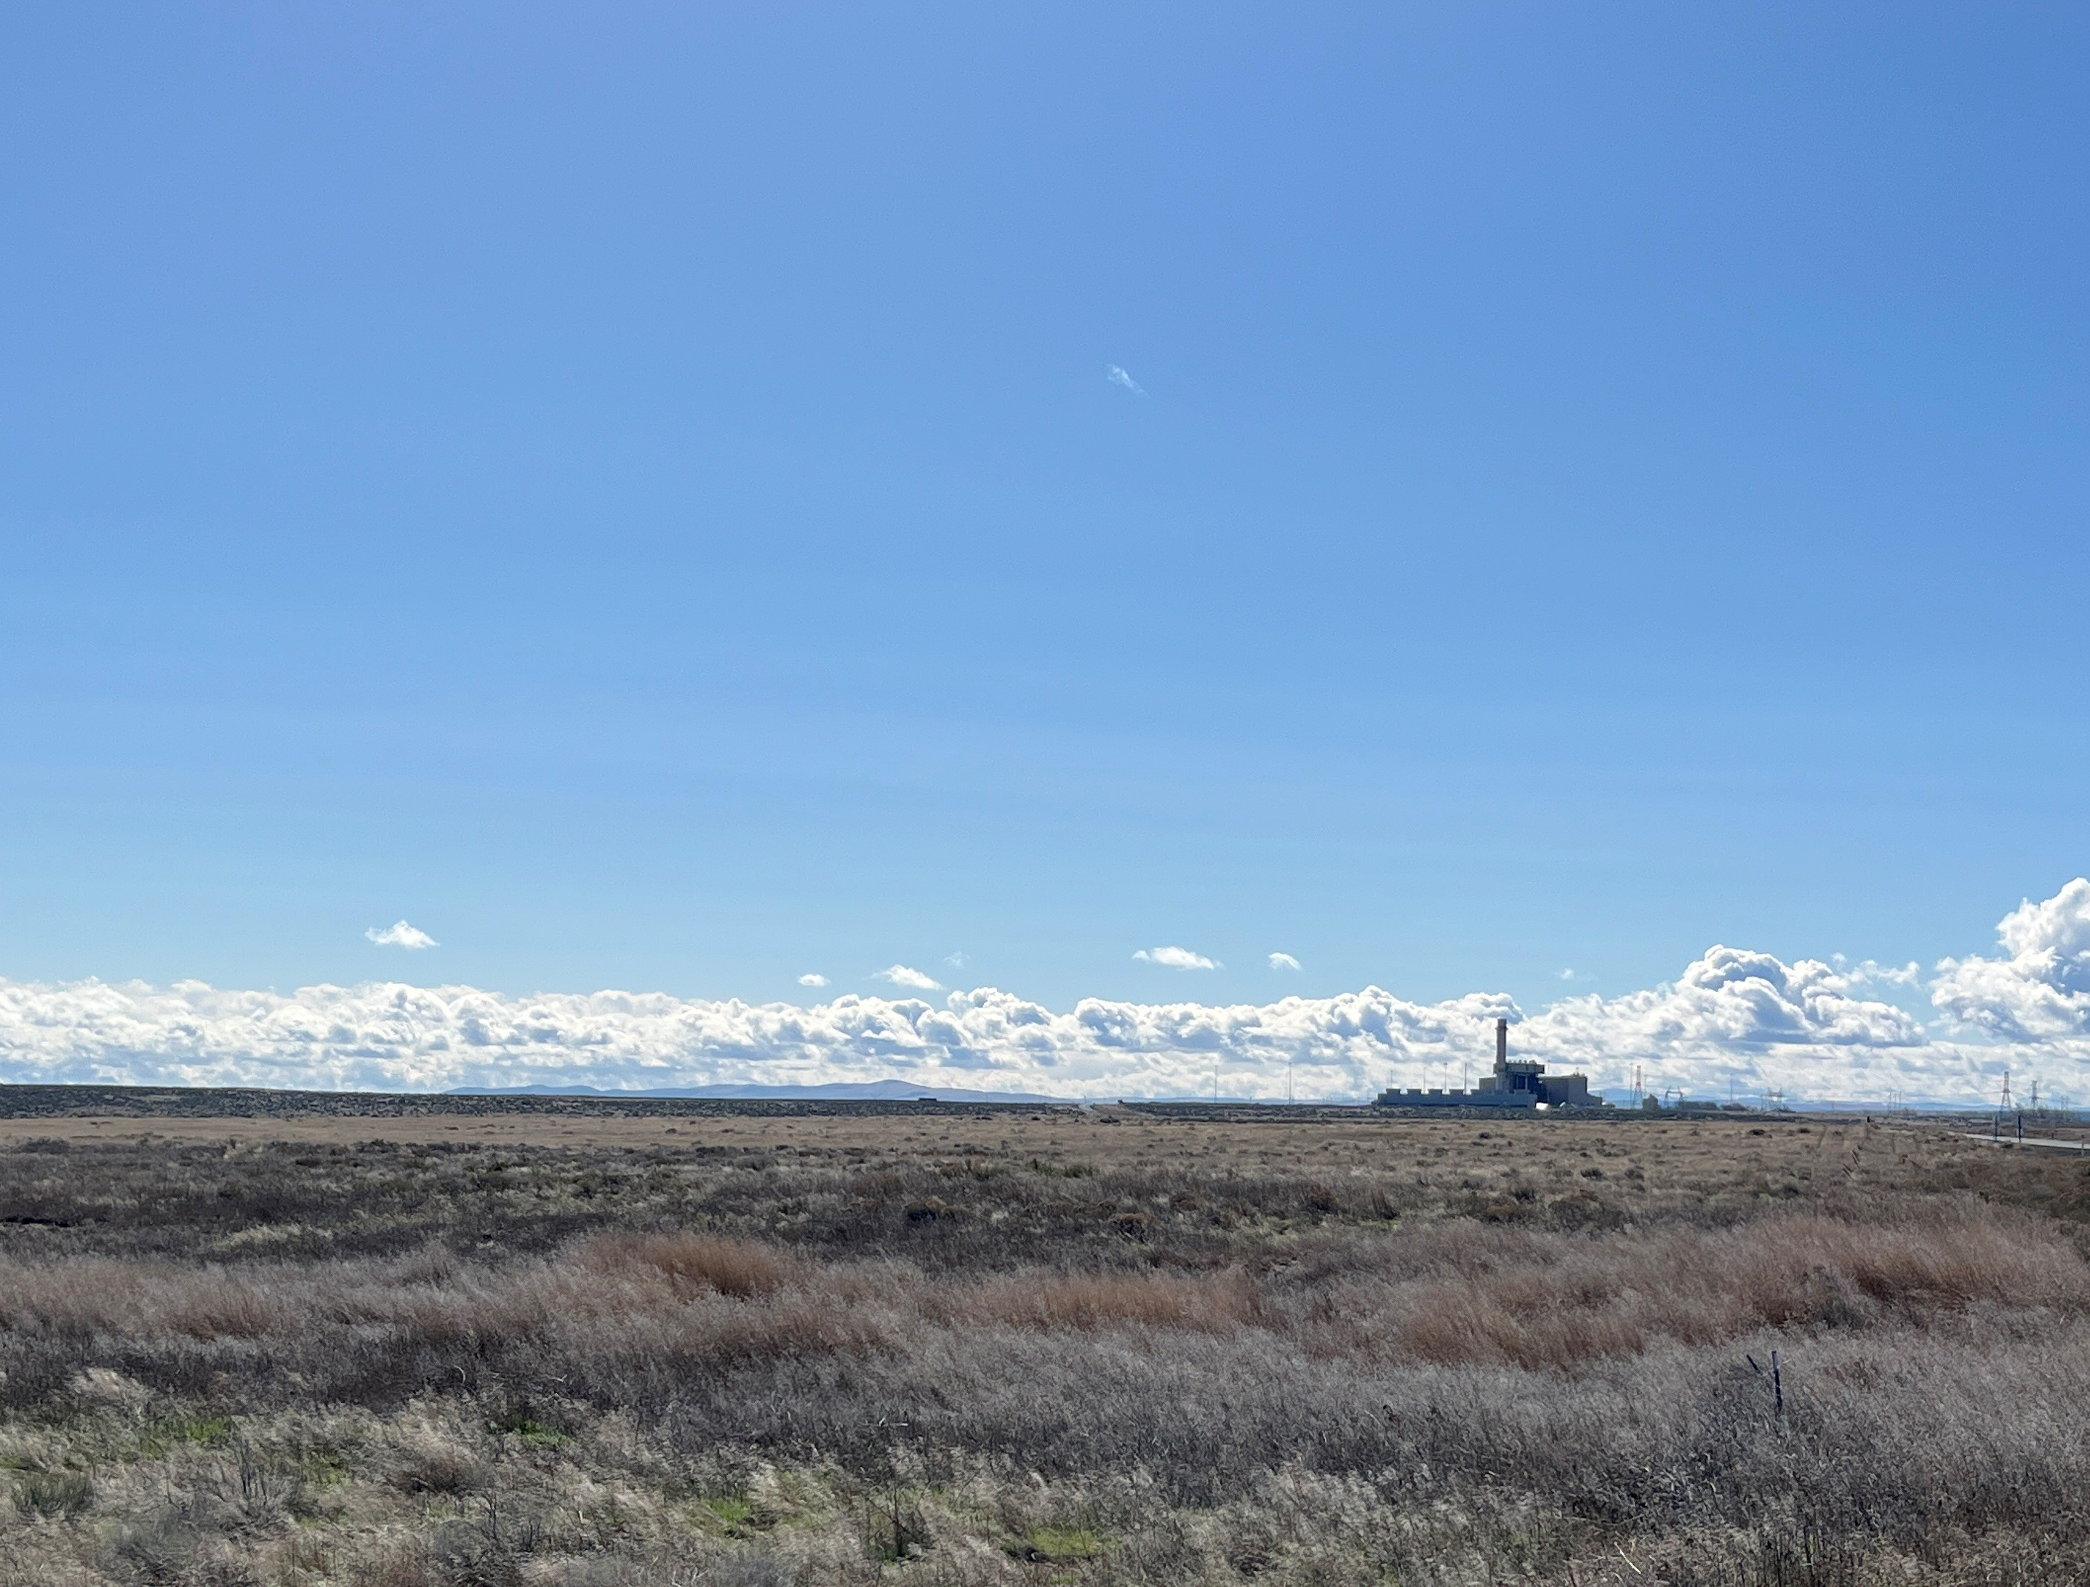
Staff Report and Public Comments
Applicant’s Response to Identified Items
  Water Supply
  Construction Traffic and Road Use Agreement
  Alternatives Analysis
  Economic Development Benefits
Outreach to Public Works Director
Outreach to Boardman Rural Fire District
Response to DLCD Comment Email

Slide 12
Applicant’s Alternatives Analysis
Develop Siting Criteria
Applicant identified 8 Siting Criteria for successful project:
  Access to electrical infrastructure and power availability
  Water supply and discharge
  Land characteristics (200+ acres, vacant, <15% slope to minimize grading, etc.)
  Environmentally sensitive resources and protected areas
  Road access
  Fiber network connectivity
  Land use and zoning
  Financial feasibility

Slide 13
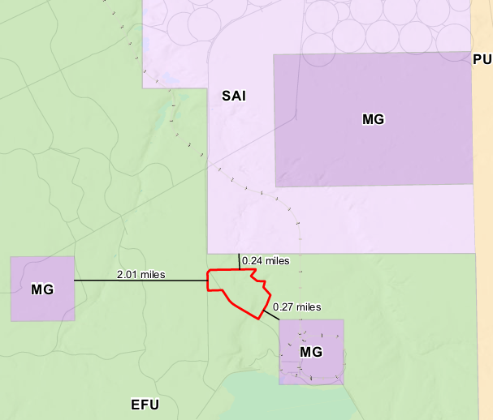
Applicant’s Alternatives Analysis (cont’d)
Identify Land and Alternatives Analysis/Methodology
Steps of Analysis:
Nonresource lands in UGBs of Umatilla and Morrow counties [Figure 6a and 6b]
Suitable zones outside of UBGs of Umatilla and Morrow counties [Figure 6a and 6b]
Nonresource lands requiring zone change but no exception [Figure 6c to 6e]
EFU land [Figure 6c to 6e]
→ Many disregarded potential alternatives sites
→ 4 alternative sites and proposed Project Parcel identified
→ Project Parcel met 7/8 siting criteria except for zoning [Figure 6f]

Slide 14
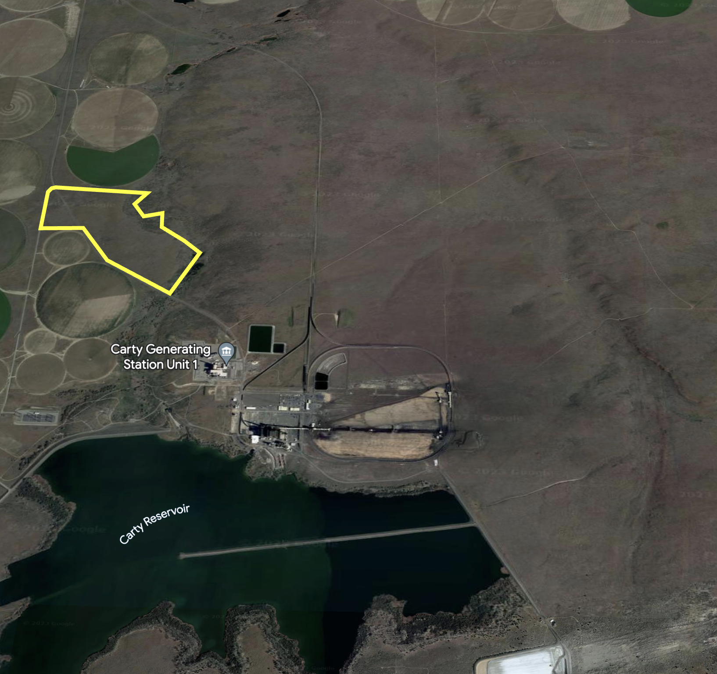
Economic Impact Benefits
Repositioning an unfarmable, economically unproductive parcel into a significant revenue-generating property.
Over half a billion dollars of capital investment will be deployed locally, with significant subsequent investment on an ongoing basis for business equipment.
A positive ripple effect of economic impacts beyond this project, given induced demand for service providers and suppliers.
Low impact on the need for public services.
Recession-strong industry; long-term fiscal revenue stream.
Hundreds of construction jobs and many well-paying permanent positions.
Multiplier effect on employment; for every data center job another four/five jobs are supported in the wider economy.

Slide 15
Economic Impact Benefits (cont’d)
Data center operator likely to support workforce development and retain high-tech jobs that will continue to be in demand in the future.
Morrow County's Comprehensive Plan's Economic Element focuses on four sectors, including "Large Industrial Activity." This project supports the policies of the Plan, specifically it advances:
  Goal 2: To expand job opportunities, reduce unemployment, reduce out-migration of youth, and accommodate growth of County workforce.
The project also supports Greater Eastern Oregon Development Corporation's Comprehensive Economic Development Plan, specifically it advances:
  Goal 1.1: Encourage industry clusters to explore opportunities for growth and expansion;
  Goal 2: Encourage diversification of local economies within the region to increase stability and resiliency.

Slide 16
Applicant’s Proposed Conditions
Prior to construction, Applicant shall enter into a Road Use Agreement with Morrow County Public Works department to fund $267,000 to pay for chip seal on the first nine (9) miles of Tower Road.
Prior to construction, Applicant shall provide notice to Threemile Canyon Farms, the area farming operator, of its construction traffic schedule and coordinate with Threemile Canyon Farms to minimize any potential impacts to farm traffic during harvest.
Applicant shall obtain all local, state and federal permits and approvals for the data center campus construction and operation including but not limited to:
  DEQ NPDES 1200-C Stormwater Permit
  DEQ, Onsite Septic Permit
  DEQ, Basic Air Contaminant Discharge Permit

Slide 17
Questions?

Slide 18
Rebuttal

Slide 19
Thank you for your consideration

