Slide 1
2024 MCZO Update
May 28 Planning commission work session

Slide 2
Overview of Amendments
Administrative/Ministerial Process Separation
Language Clarity and Consistent Terminology
Amending Section 10.030 to reference the Code Enforcement Ordinance
Allowing the conversion of eligible existing dwellings on EFU land to non-farm dwellings
Specifying Vesting Requirements, Extension Process
Comment Period/Appeal Period Changes
CUP Process Discussion
Other optional amendments

Slide 3
Administrative/Ministerial Processes
Ministerial (Not Land Use Decisions)
Zoning Permit
Building Permit
Land Use Compatibility Statement
Ministerial decisions are staff decisions, made without notice or hearings. They must be made using only clear and objective standards.
Administrative (Land Use Decisions)
Site Plan Review
Land Partition
Minor Variance
Administrative decisions are also staff decisions; however, they do require public notice, findings, and an opportunity for public comment. Decisions that require discretion or interpretation must be Administrative.

Slide 4
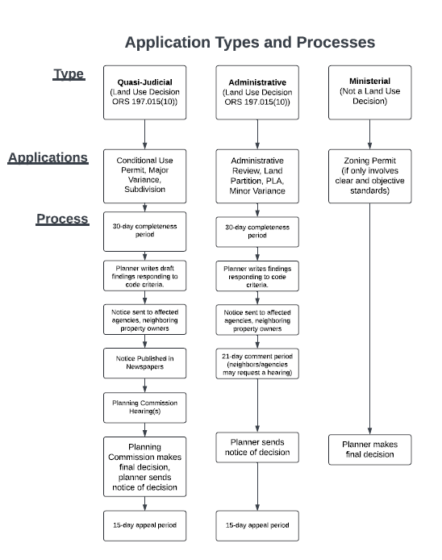

Slide 5
Zoning Permits
Zoning Permits are ministerial permits that serve two purposes:
To review uses that are allowed outright, using only clear and objective standards. (e.g. confirming that a house meets setbacks in a residential zone.)
To confirm that conditions of approval have been met for uses that are subject to administrative review (e.g. confirming that DEQ permits have been received and transportation improvements have been completed for a large industrial development after CUP approval)

Slide 6
Administrative Triggers
Uses with Specific standards/limitations
Development that requires a TIA
Development that uses municipal services outside of a UGB.
Development within overlay zones.
Development that includes new roads.
Applications that include variances.

Slide 7
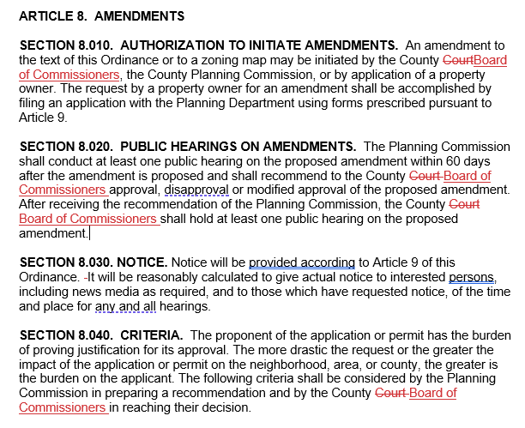
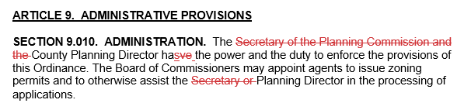
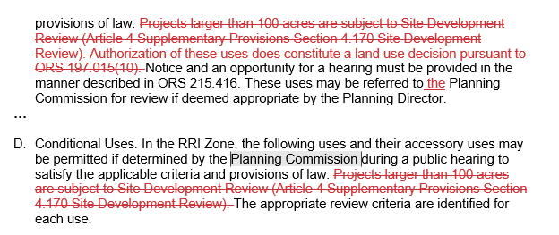
Language Clarity & Consistent Terminology
Replacing instances of “County Court” with “Board of Commissioners”
Removing reference to the “Secretary of the Planning Commission”
Removing reference to “Site Development Review” Option: remove obsolete zones (Speedway overlay, Resource-Related Industrial)

Slide 8
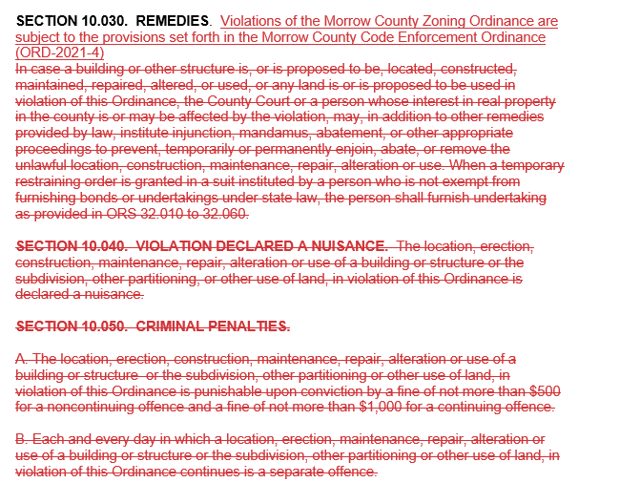
Amending Section 10.030 to reference the Code Enforcement Ordinance

Slide 9
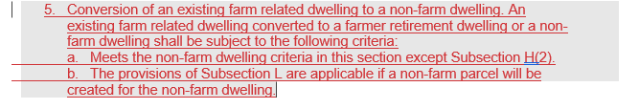
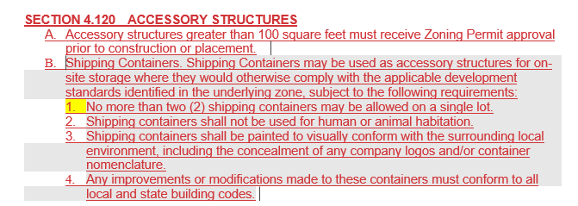
Notes:
Packet page 107 and page 11 Non Farm conversion - waiting feedback from DLCD. Shipping Container language is similar to Umatilla County. Packet Page 28.

Slide 10
Clarification of Extensions/Vesting Requirements
Expiration Dates
SPR/CUP approvals valid for 2 years.
Dwellings in Farm/Forest Zones valid for 4 years.
Extensions
Director can grant a 1-year extension (clear/objective).
Zoning permits can be extended one time.
Vesting
Land Use Decisions are vested when Zoning Permit is granted.
Zoning Permit is vested when building permit is granted.
Notes:
Expiration dates are NOT changing. Clarification on extensions.

Slide 11
Administrative Review process (current)
30-day completeness period
Staff sends out tentative decision/findings
21-day comment period
If a hearing is requested, an additional notice of public hearing is sent out. If not, the decision is final after 21-day comment period.
Staff sends notice of final decision
15-day appeal period

Slide 12
Administrative Review process (proposed)
30-day completeness period
Staff sends out tentative decision/findings
21-day comment period
If a hearing is requested, an additional notice of public hearing is sent out. If not, the decision is final after 21-day comment period.
Staff sends notice of final decision
15-day appeal period (option to provide more time)

Slide 13
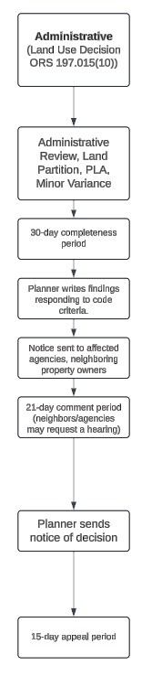
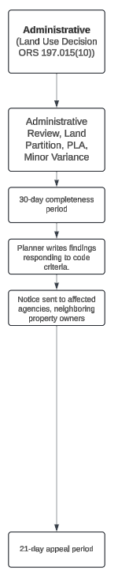
Comment Period/Appeal Period
Our current process for Land Use Decisions requires staff to send a preliminary notice initiating a 21-day comment period and then send a final notice initiating a 15-day appeal period. State law does not require us to provide the initial comment period.
Staff recommends consolidating the comment period and the appeal period, and providing a 21-day appeal period, during which time a member of the public can request a “de novo” hearing. The appeal period may be as short as 12 days.

Slide 14
CUP Process
Common Types:
Home Occupation Permits
Residential Uses in Commercial Zones
Renewable Energy Facilities in Resource Zones
Aggregate Mining Operations
Other Examples of CUP Uses:
Golf Courses in residential and EFU zones
Sewage treatment facilities in residential zones
Personal Use Airports in the EFU Zone
Hospitals and mobile home parks in the SR zone
Notes:
Goal 11 also required for sewage system/facility.

Slide 15
Questions/Comments

Slide 16
THANK YOU
Daisy Goebel, AICP
Morrow County Planning
(541) 922-4624
dgoebel@co.morrow.or.us

